Slide 1

Prediction of CO2
Group 6
Mentor Name:-Venkata Mukesh
Date:- 04/Dec/21

Slide 2
Business Problem:
To forecast Co2 levels for an organization so that the organization can follow government norms with respect to Co2 emission levels.
Objective:
The objective of the analysis is to predict an item when sold, what is the probability that customer would file fraudulent / Genuine warranty and to understand important factors associated with them
The dataset is having incidents raised by customers. Which contains an event log of an incident management process extracted from a service desk platform of an IT company

Slide 3
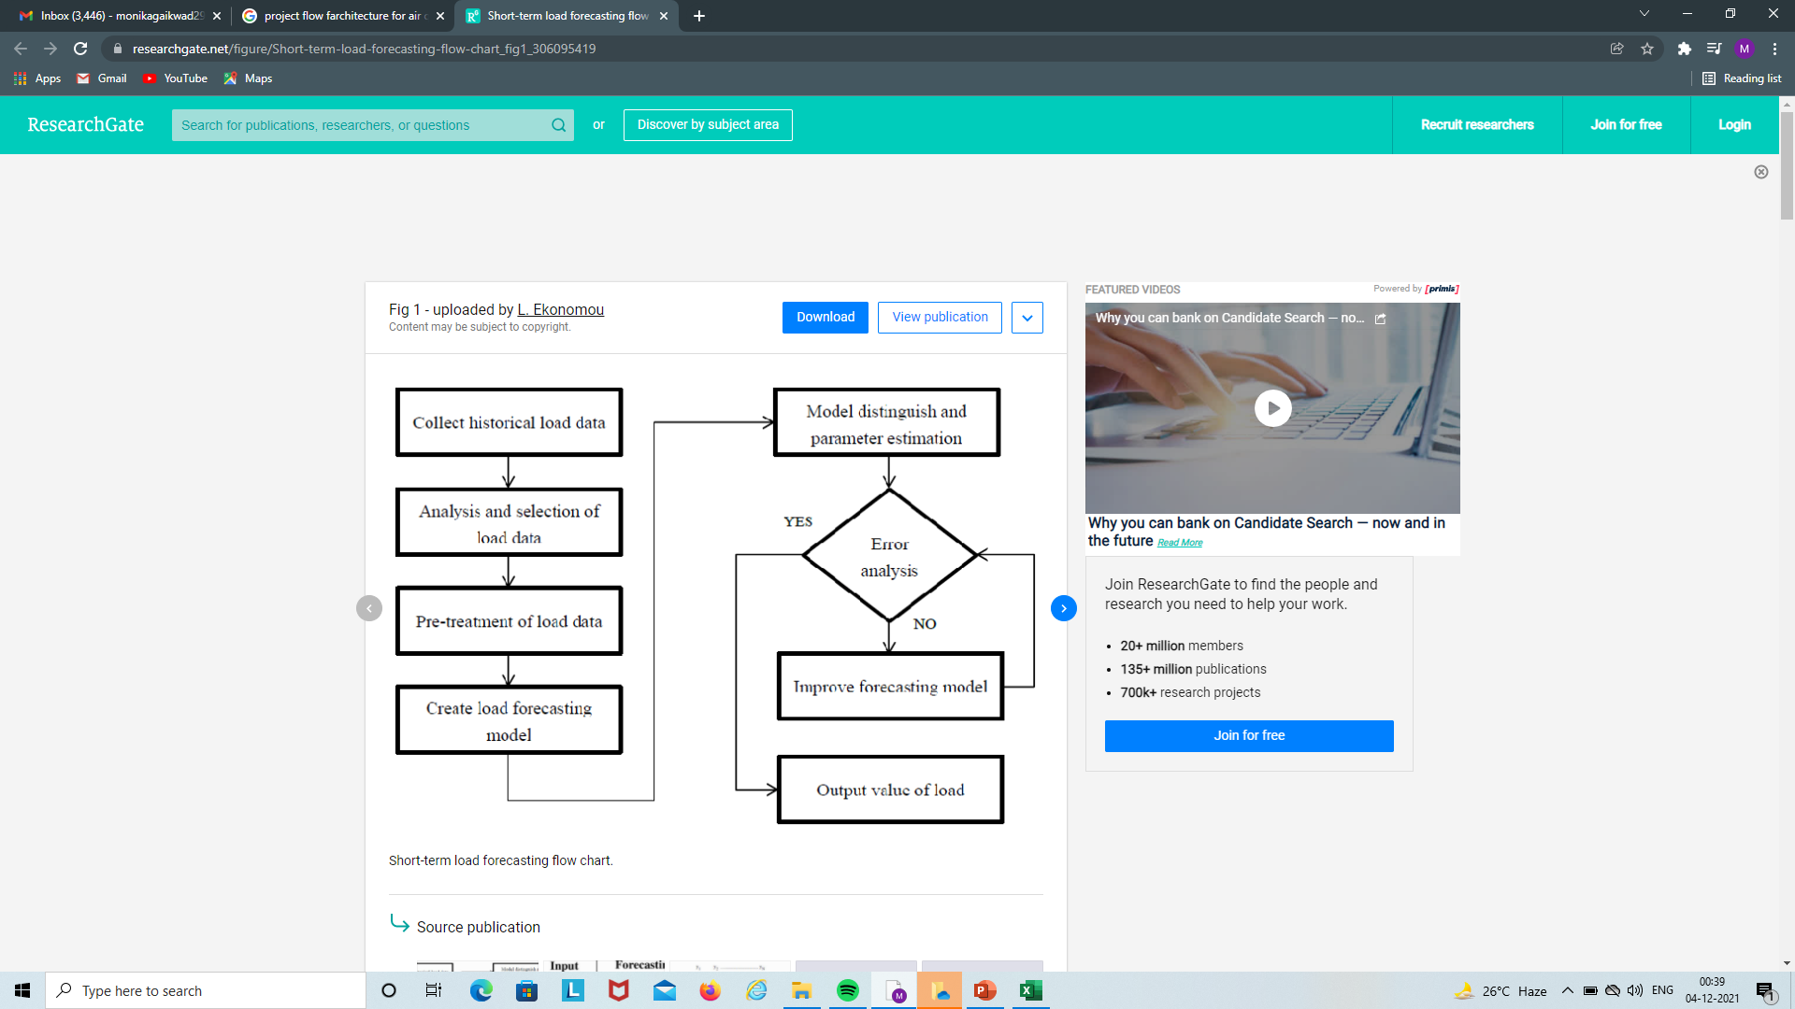
Project Architecture / Project Flow

Slide 4
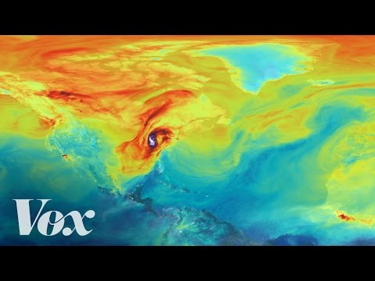

Slide 5


Slide 6
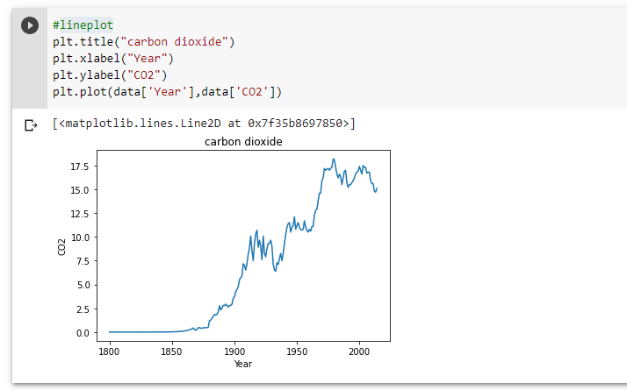
Lineplot

Slide 7
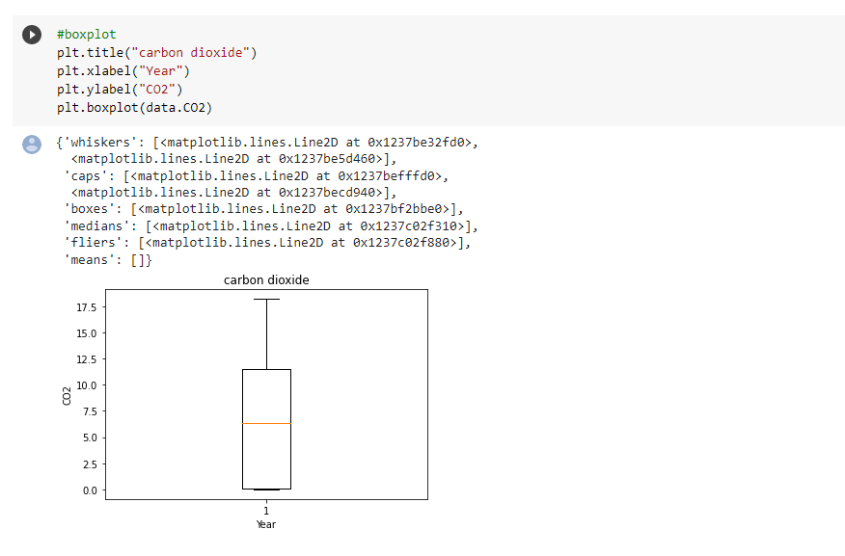
Boxplot

Slide 8
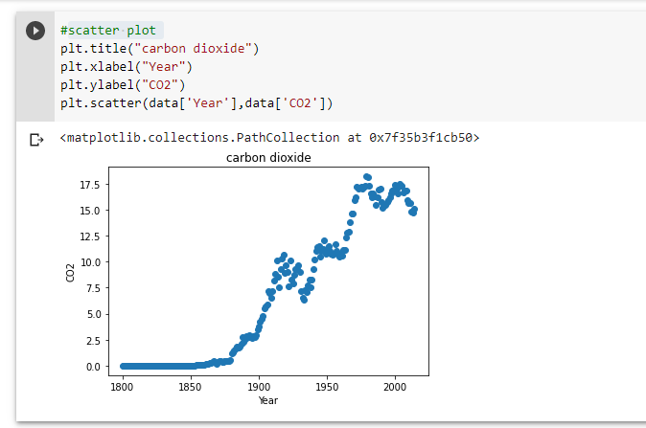
Scatter plot

Slide 9
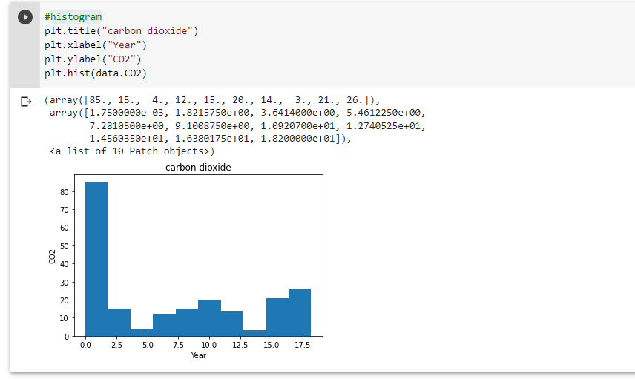
Histogram

Slide 10
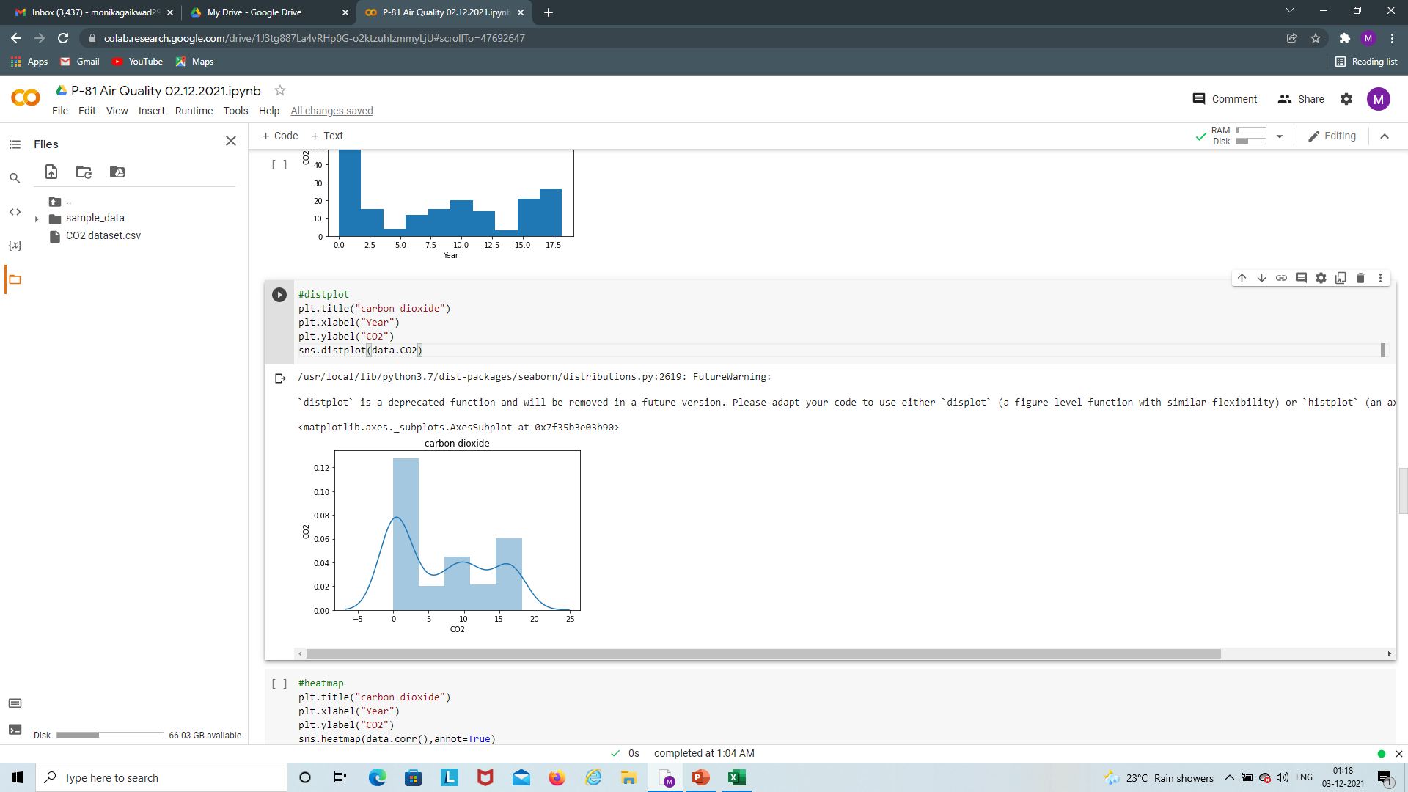
Distplot

Slide 11
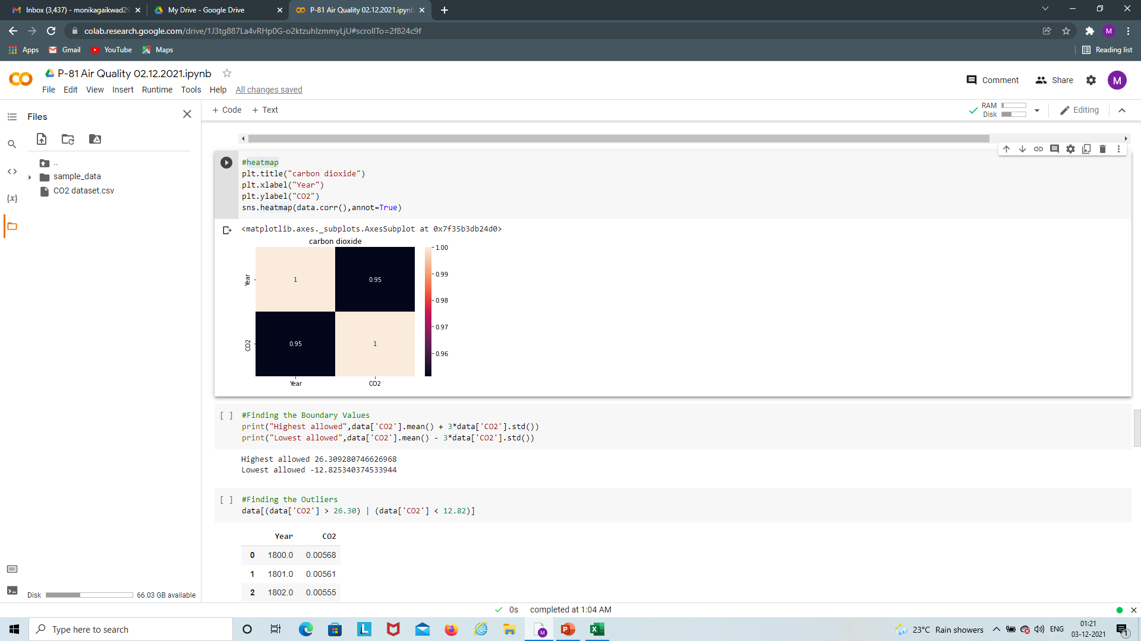
Heatmap

Slide 12
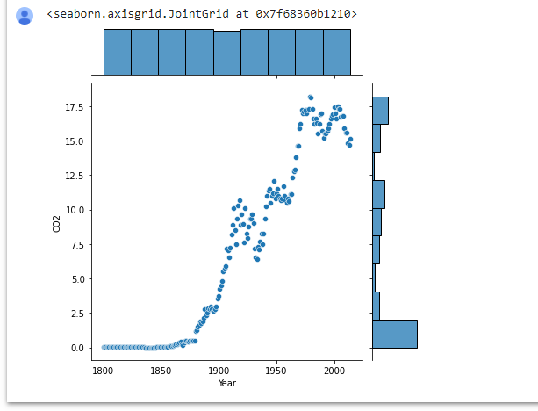

Slide 13
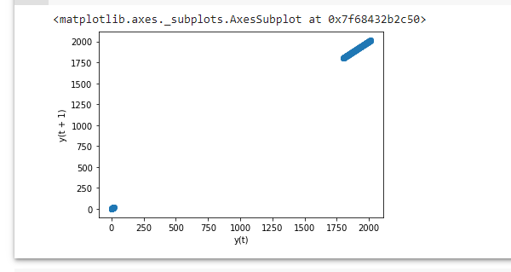
# Lag Plot

Slide 14
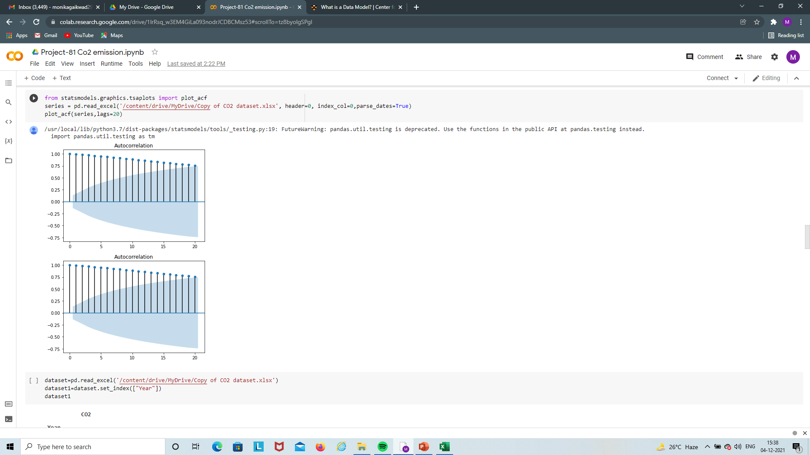

Slide 15
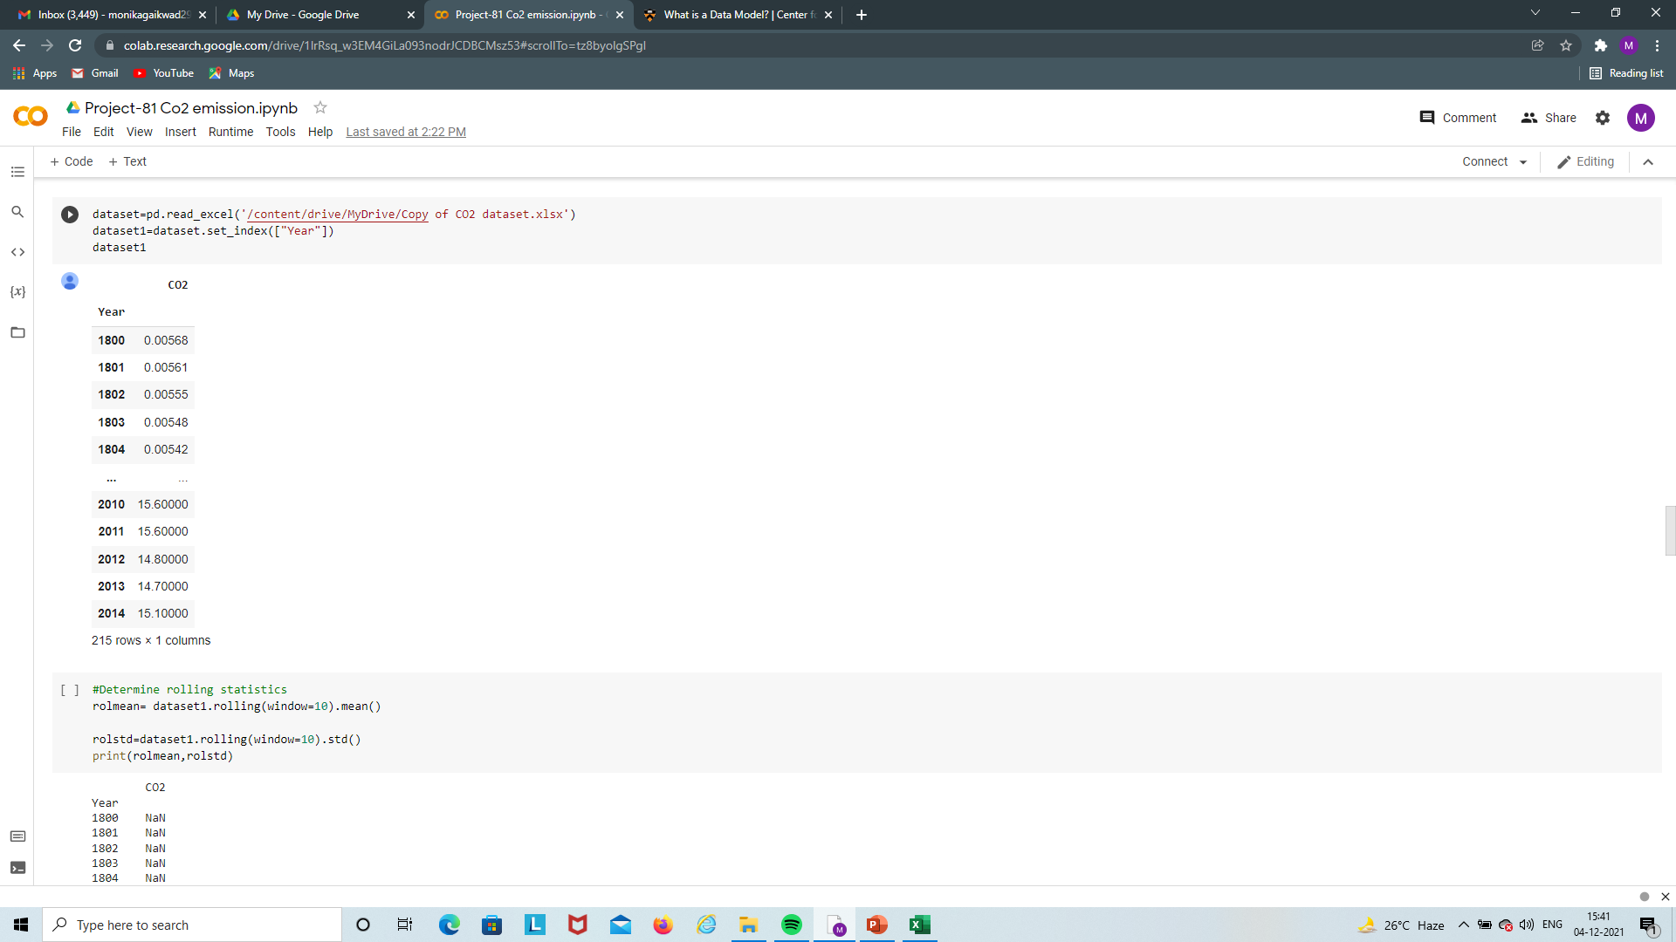

Slide 16
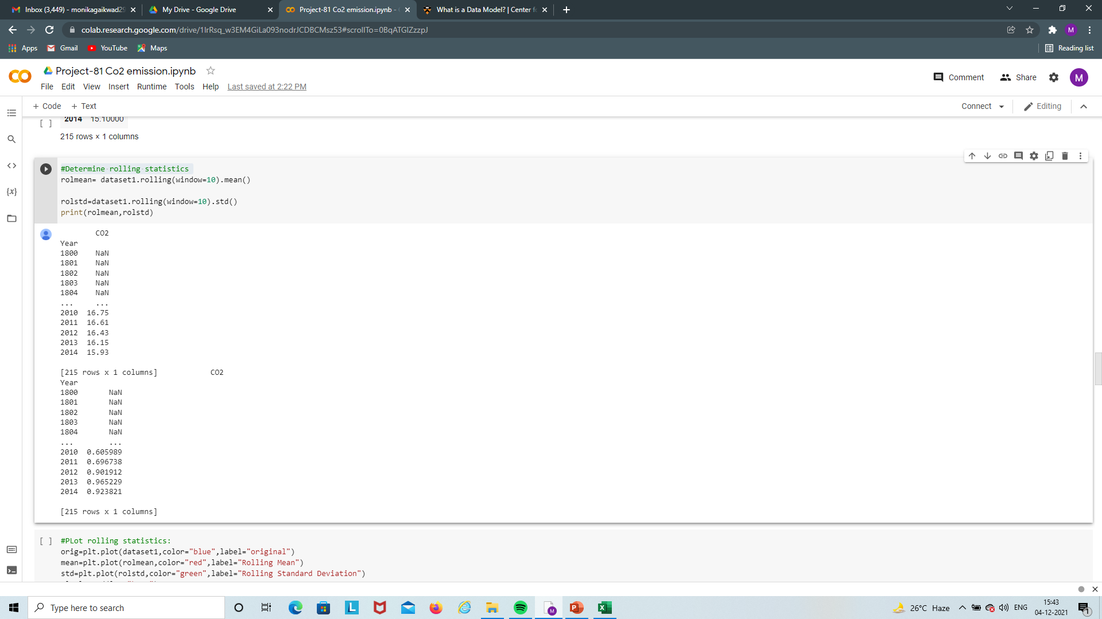
#Determine rolling statistics

Slide 17
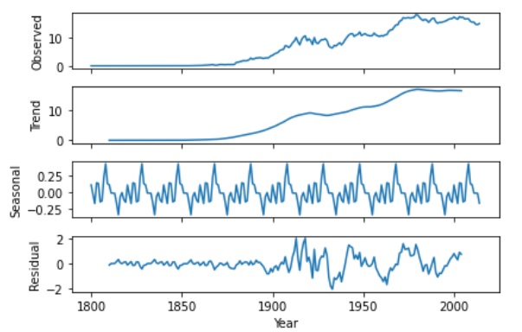
# Seasonal Decompose “Additive “

Slide 18
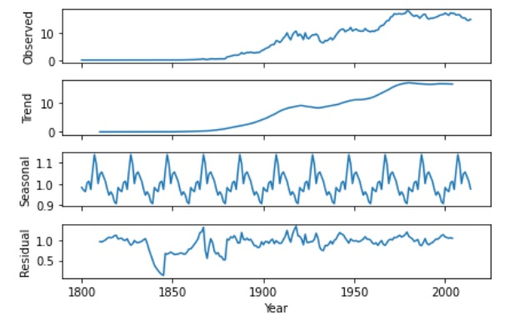
# Seasonal Decompose “Multiplicative “

Slide 19
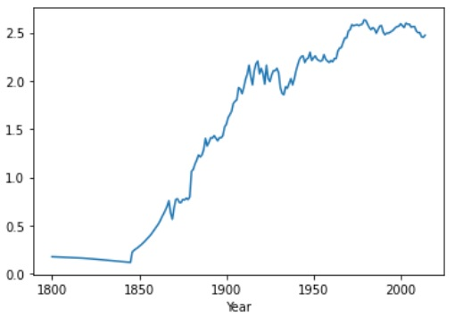
# Transformation – Adj Cube root

Slide 20
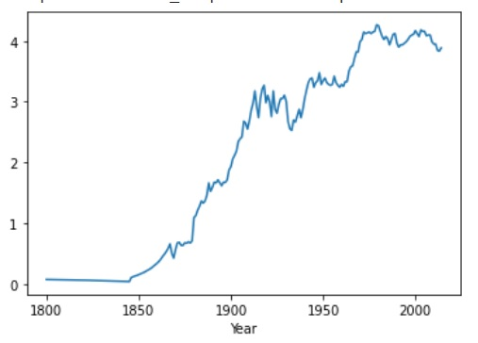
# Transformation – Square root

Slide 21
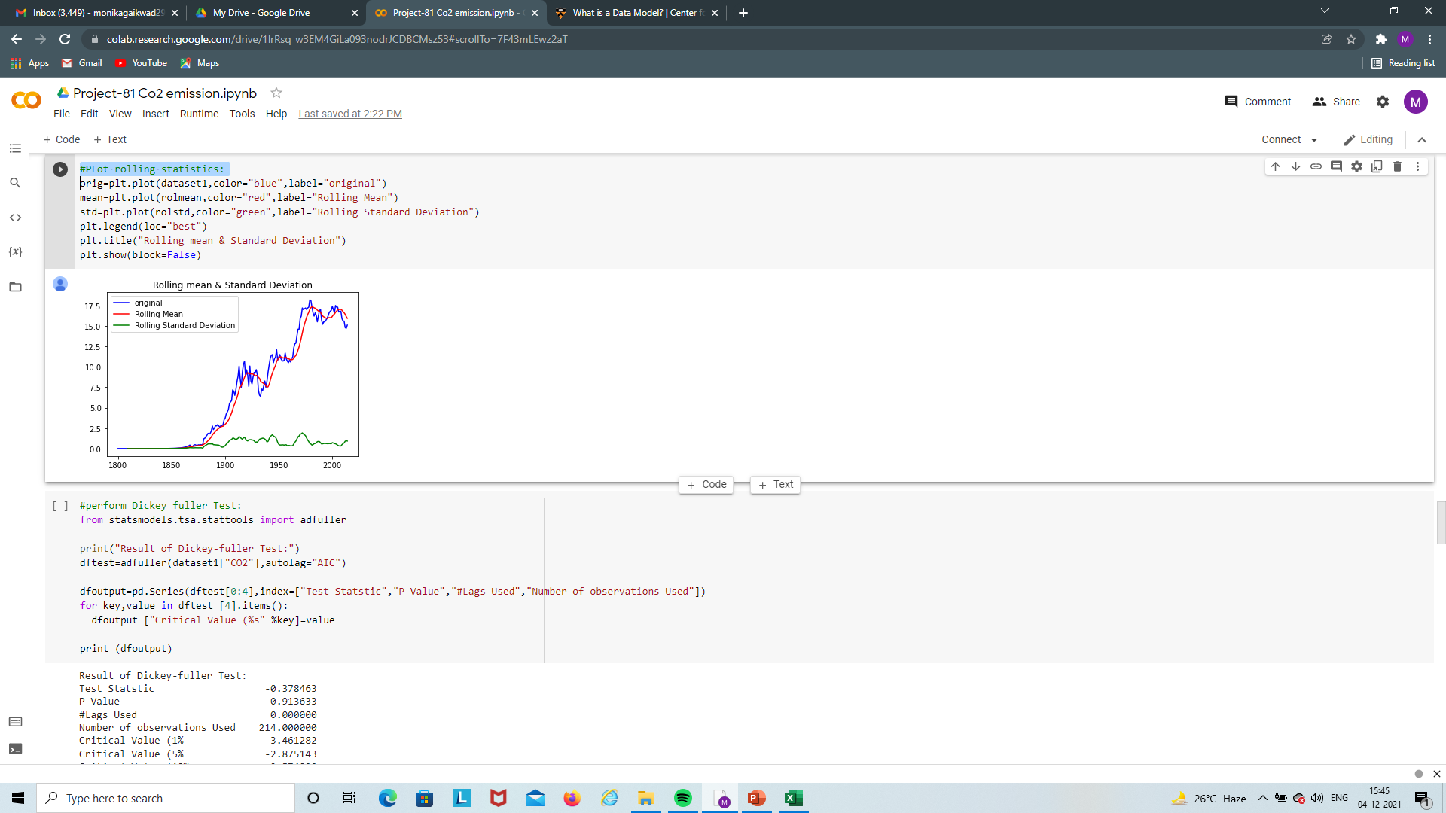
#Plot rolling statistics:

Slide 22
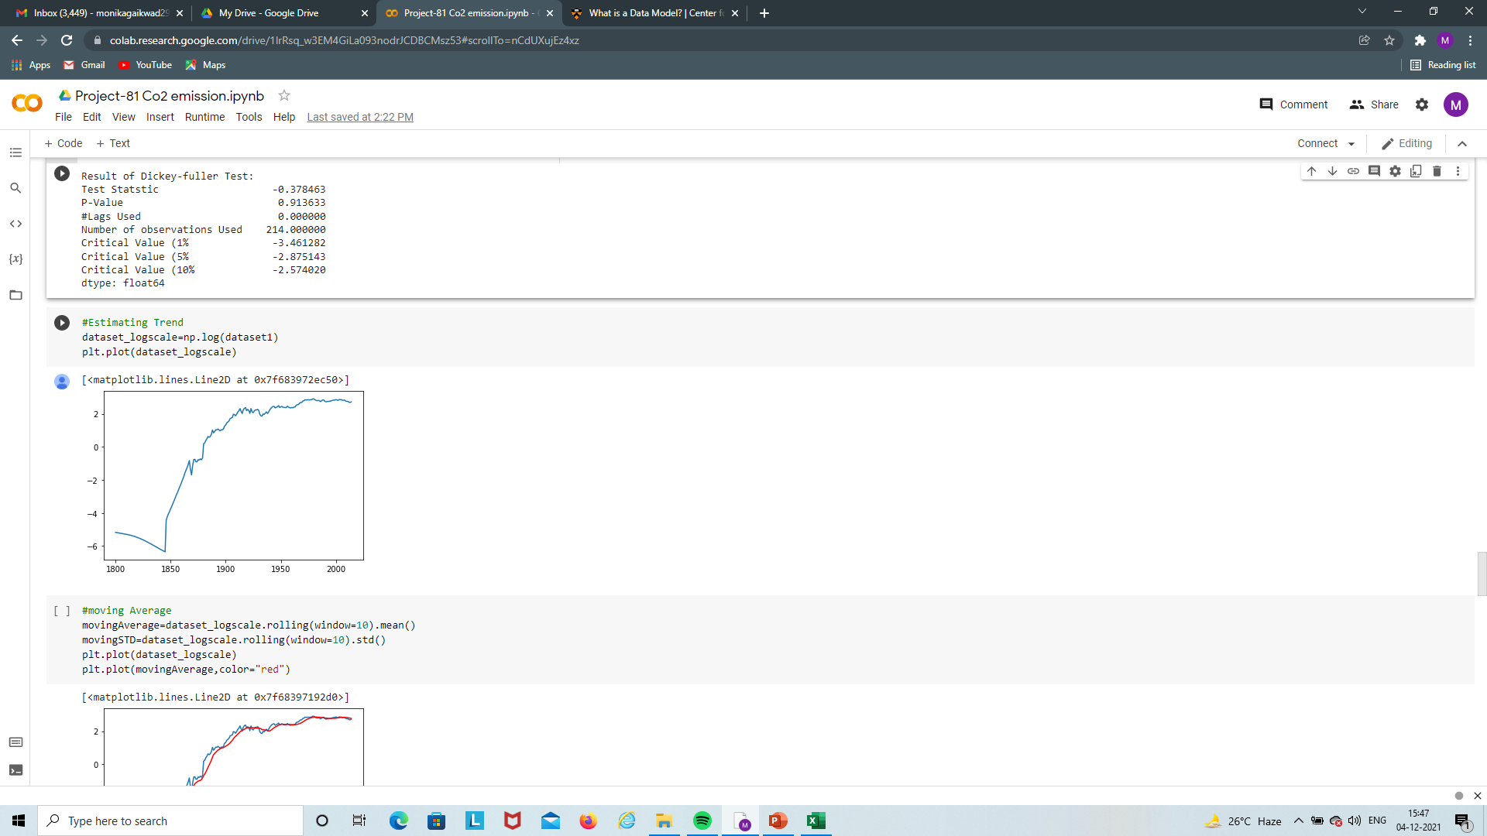
#perform Dickey fuller Test:

Slide 23
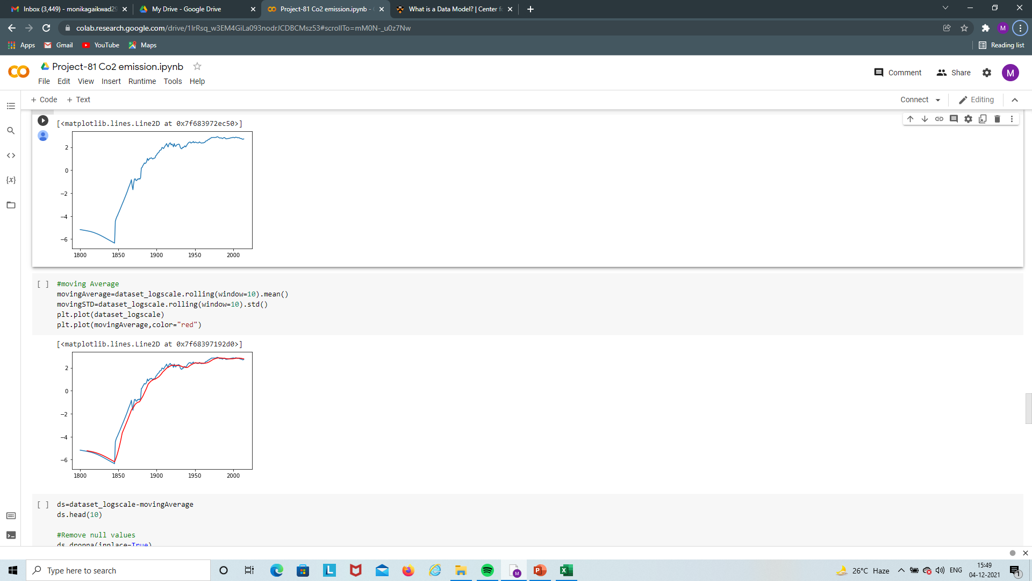
#Estimating Trend

Slide 24
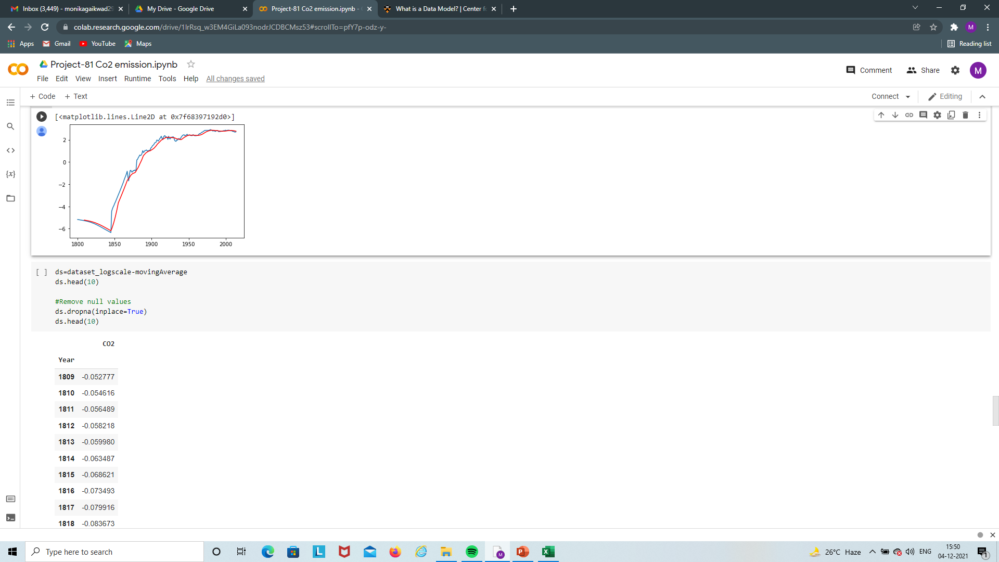
#moving Average

Slide 25
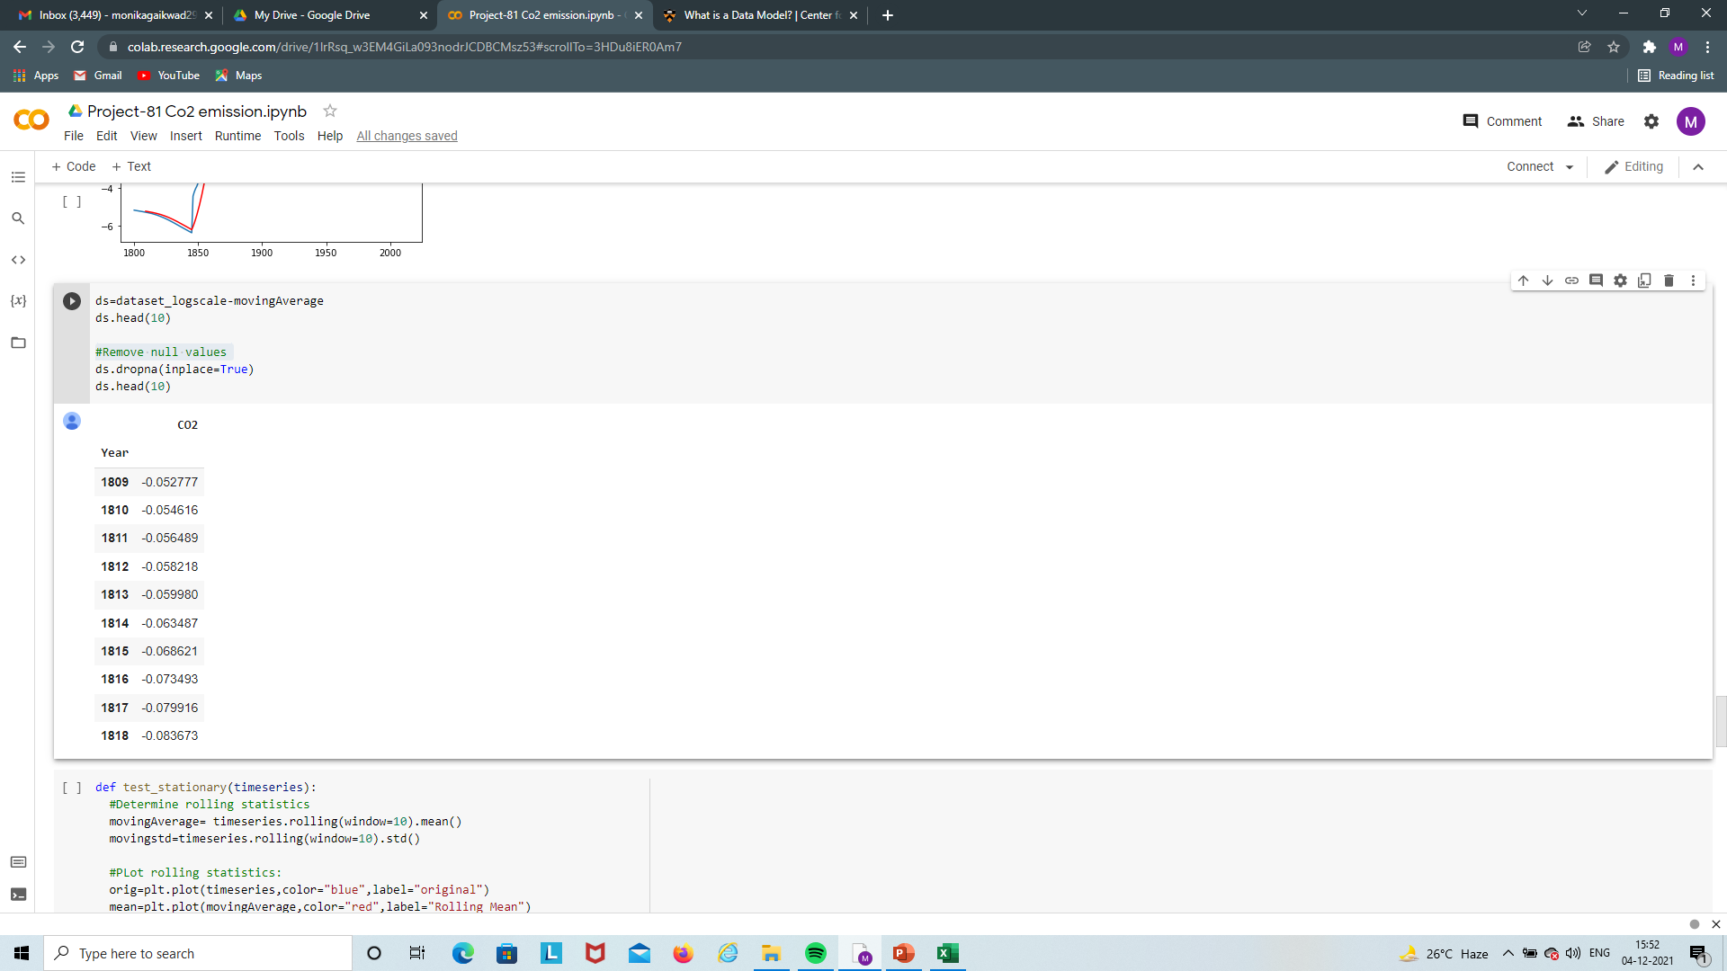
#Remove null values

Slide 26
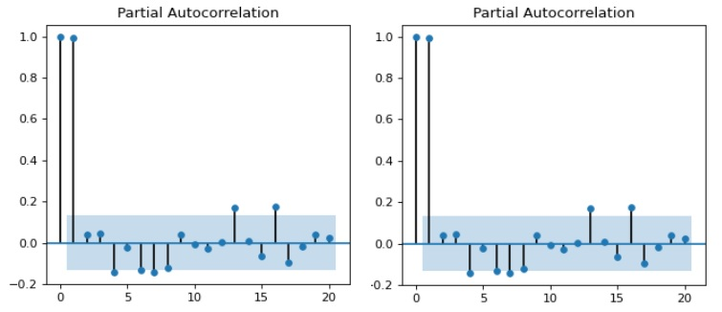
# Partial Auto Correlation

Slide 27
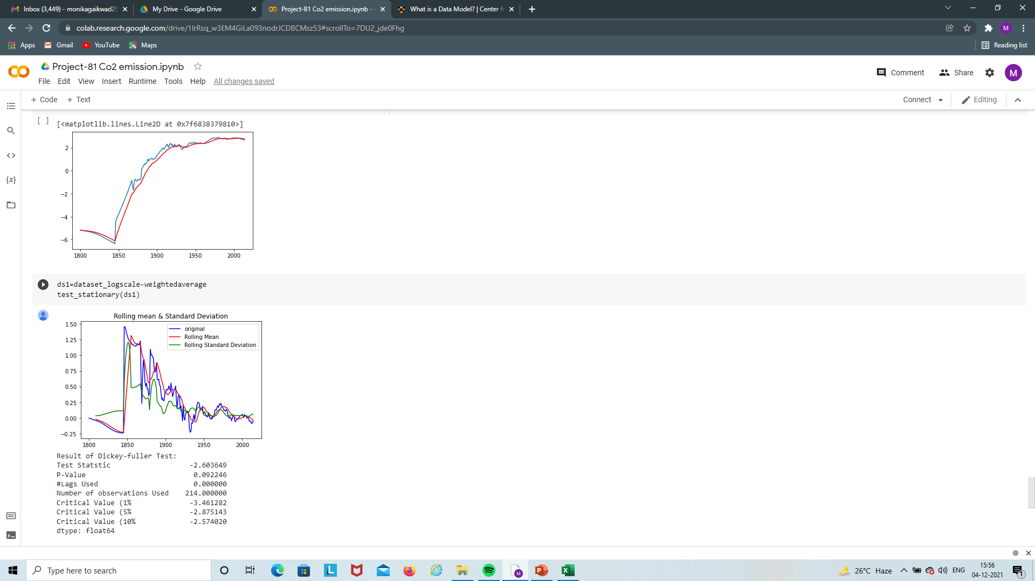
# Weighted Average

Slide 28
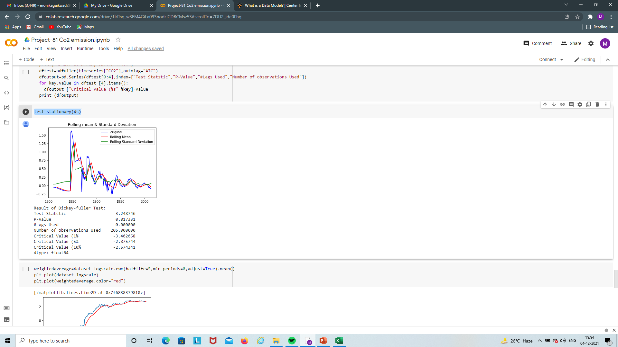
# Dickey Fuller Test
Here Our task to data has to be stationary. For that we will done some smoothing techniques.

Slide 30
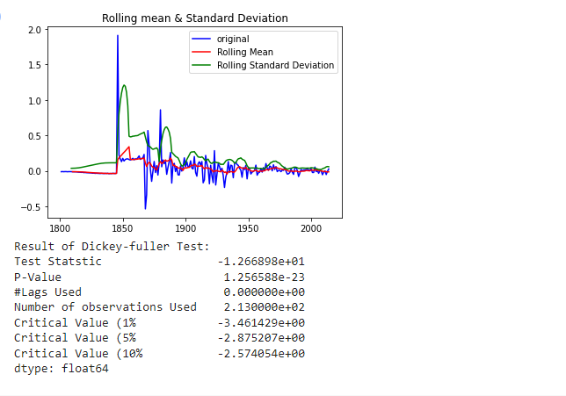
# log different shifting
For the accenptance the smoothing my Ho: 0, that is P-value should be less than 5% of signifiance

Slide 31
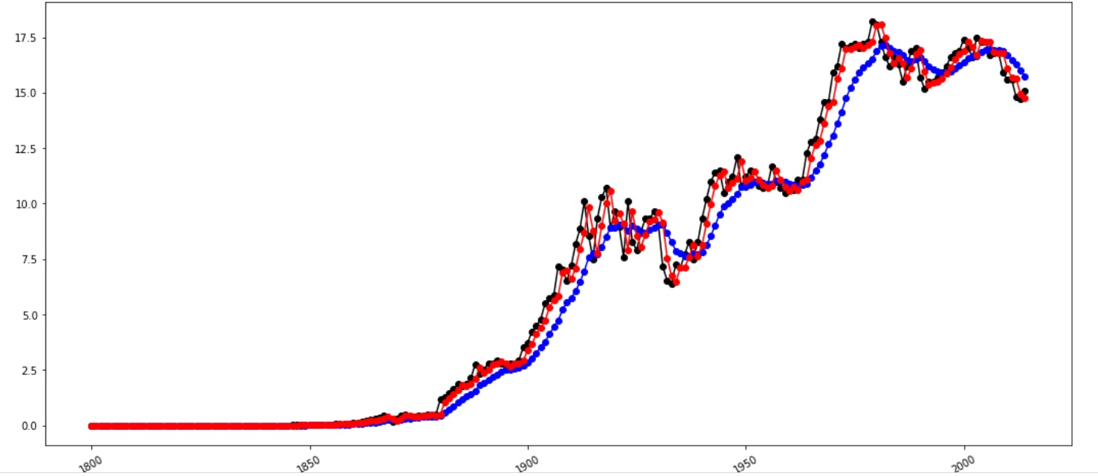
# Single Exponential Smoothing

Slide 32
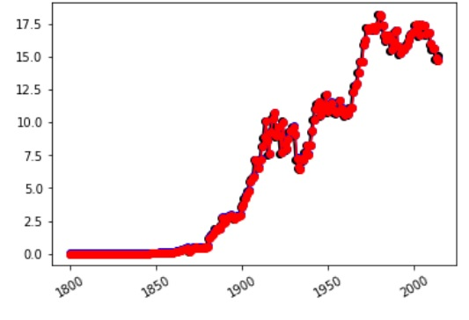
# Holt Exponential Smoothing

Slide 33
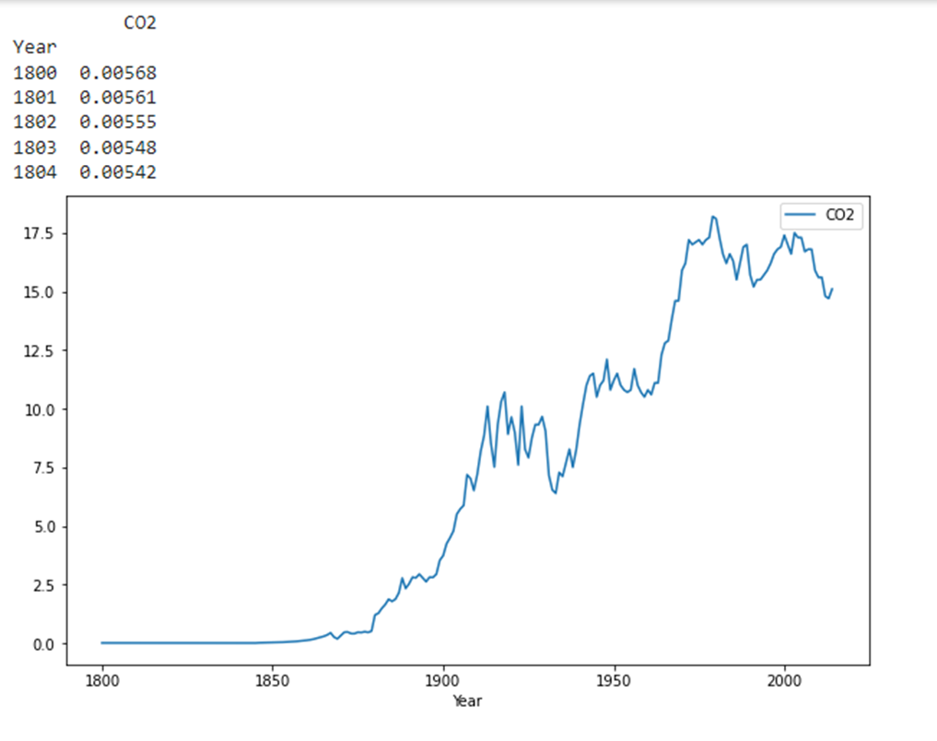
#Autoregressive model

Slide 34
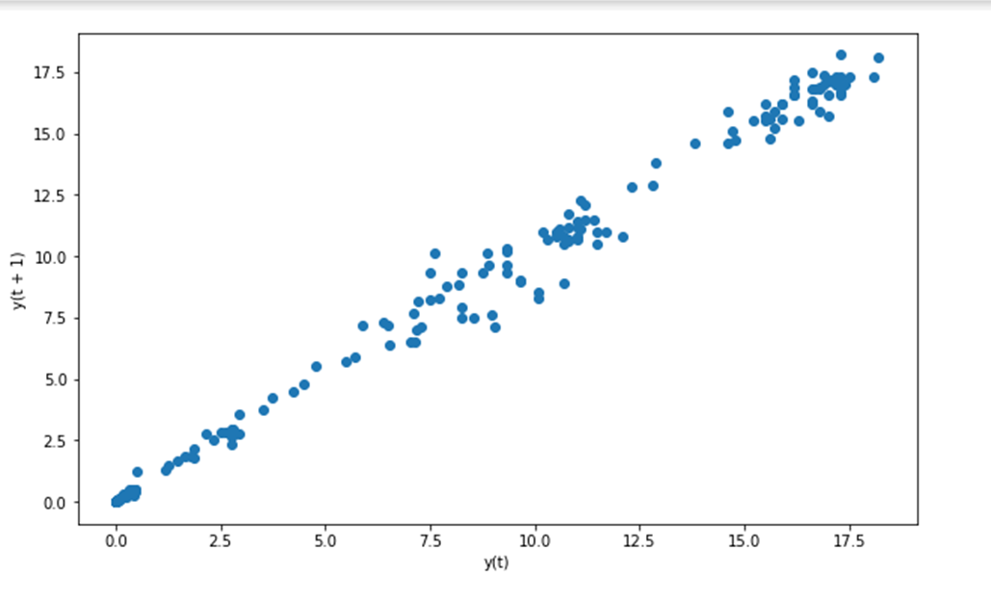

Slide 35
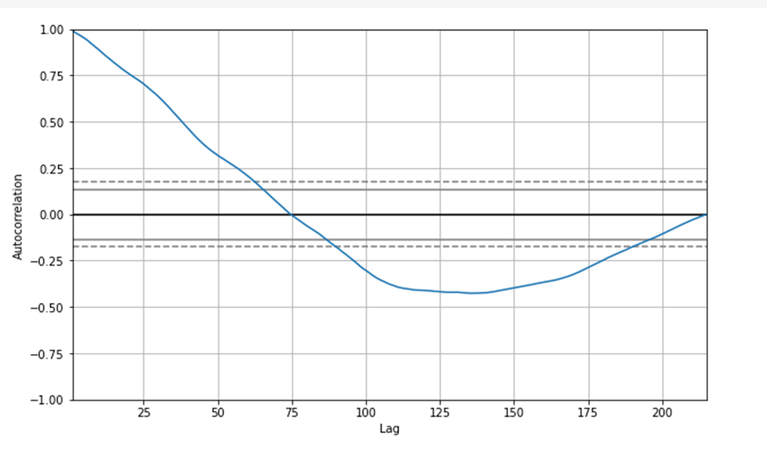

Slide 36
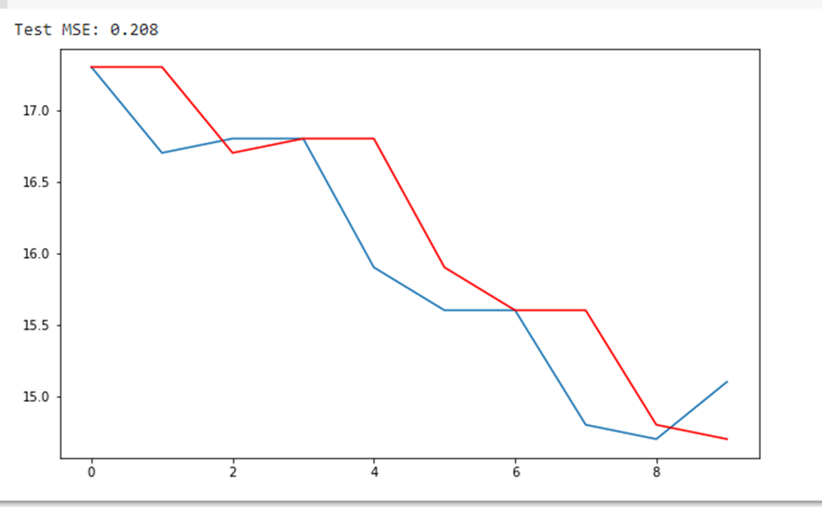
# plot predictions vs expected

Slide 37
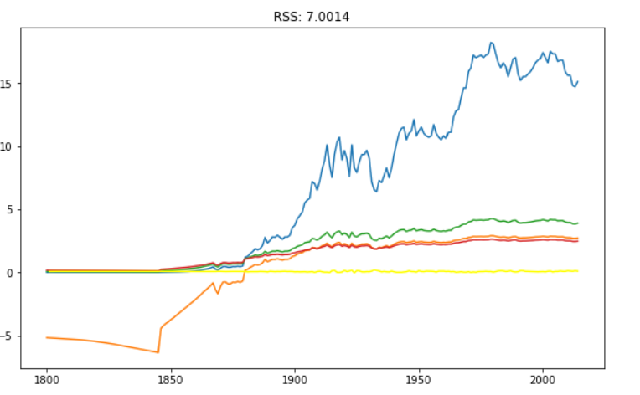
# ARIMA Model

Slide 38
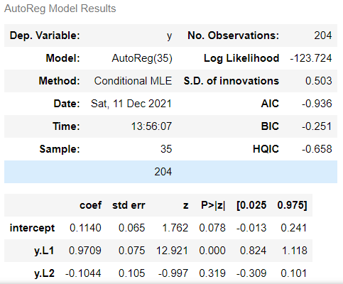
#ARIMA Summary

Slide 39
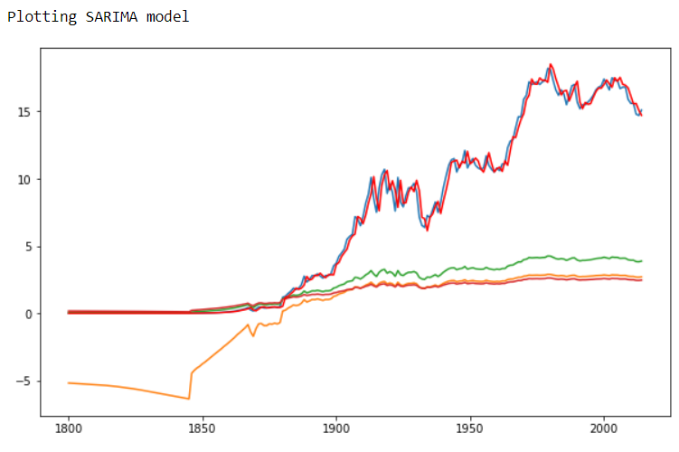
# SARIMA Model

Slide 40
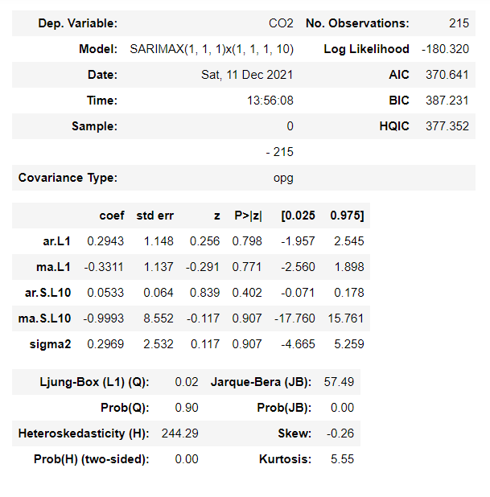
# SARIMA Summary

Slide 41
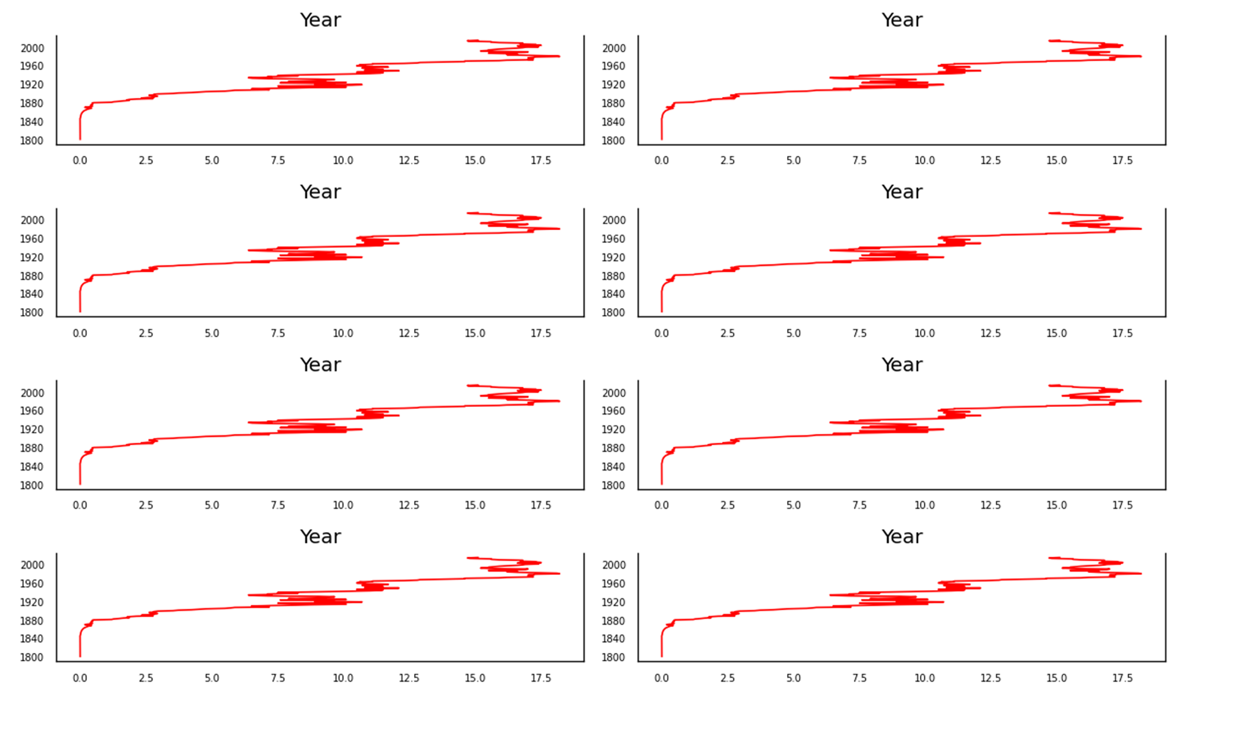
#Vector Autoregression (VAR)

Slide 42
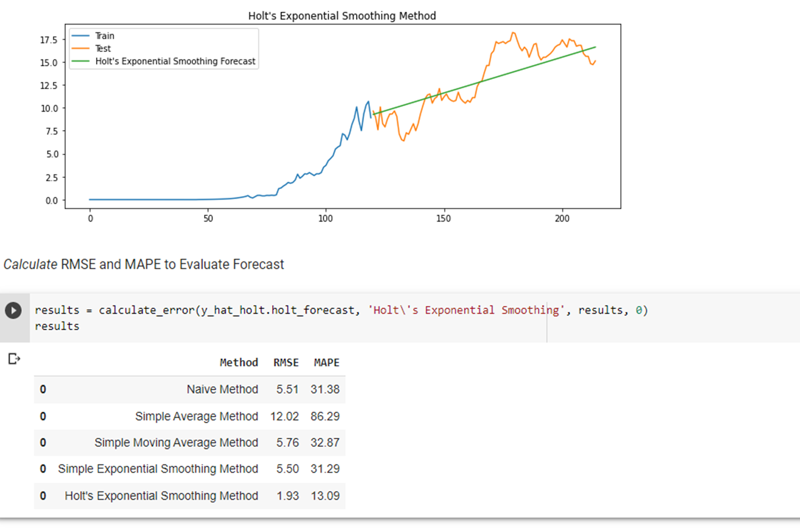

Slide 43
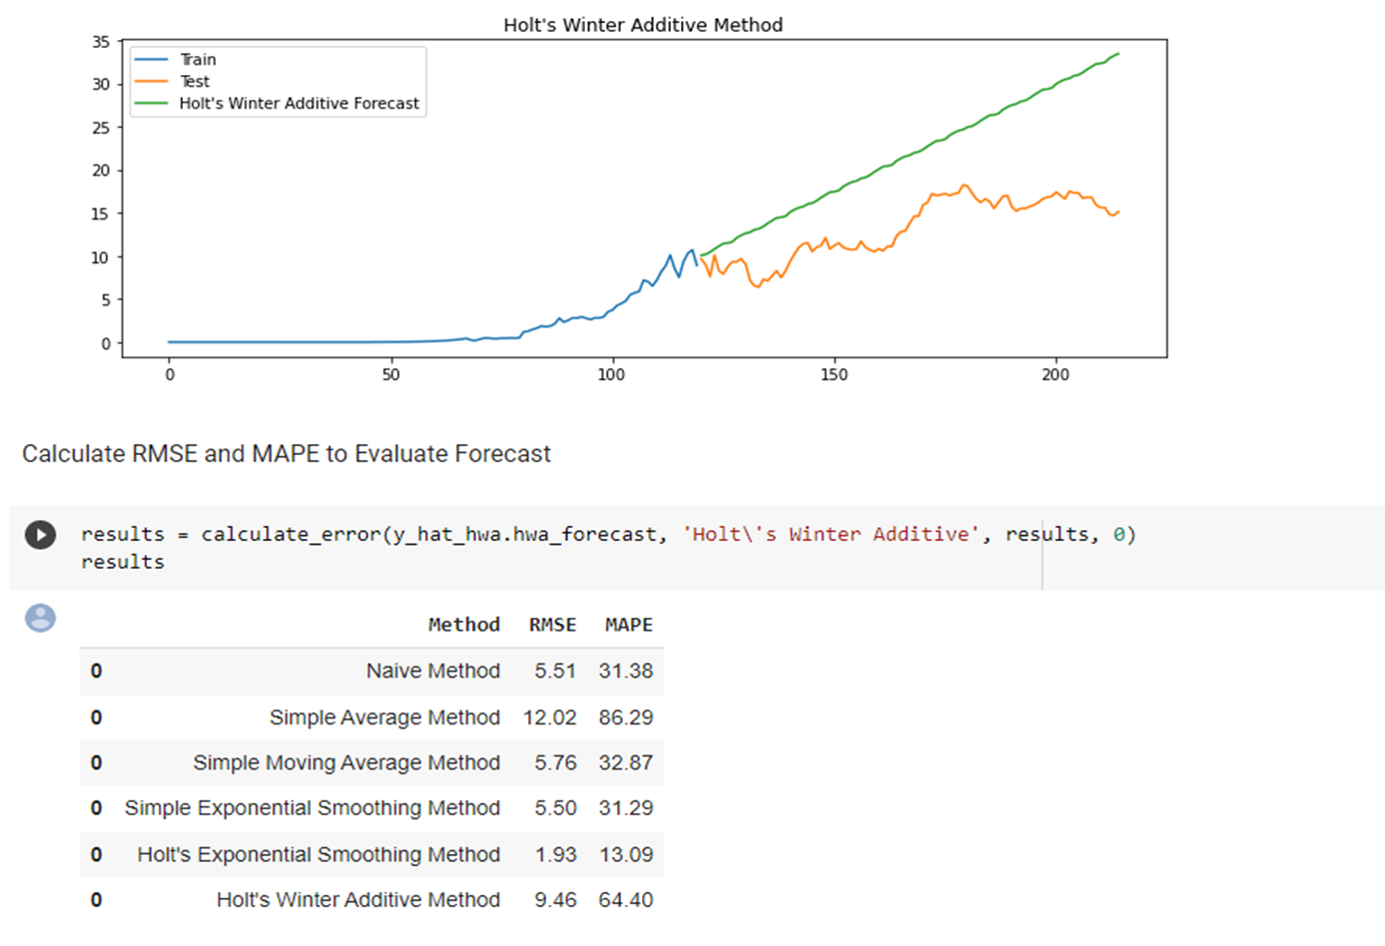

Slide 44
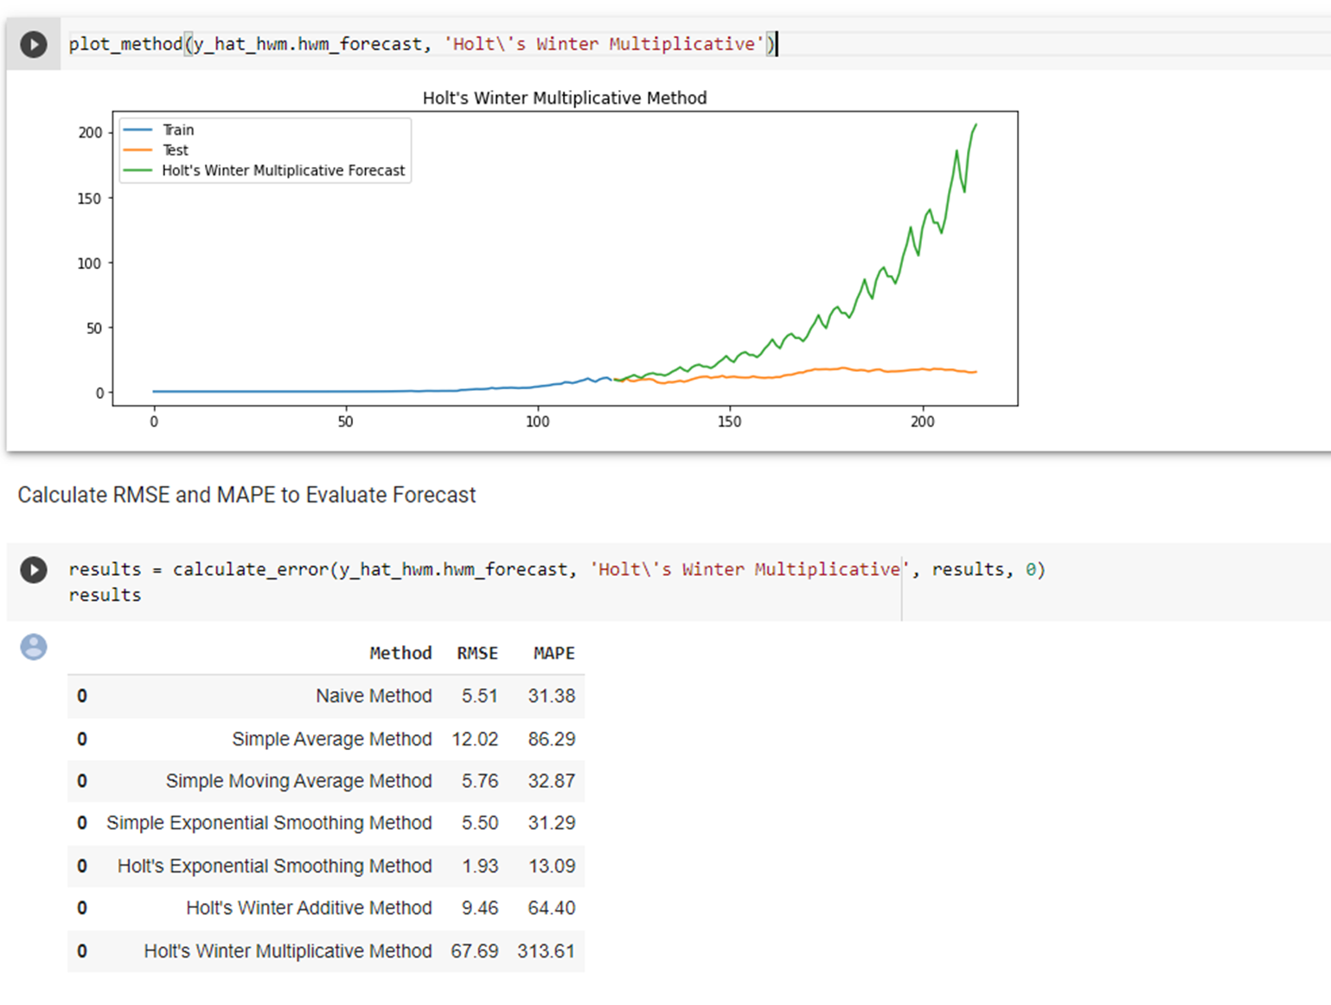
Holt Winters Multiplicative Method with Trend & Seasonality

Slide 45
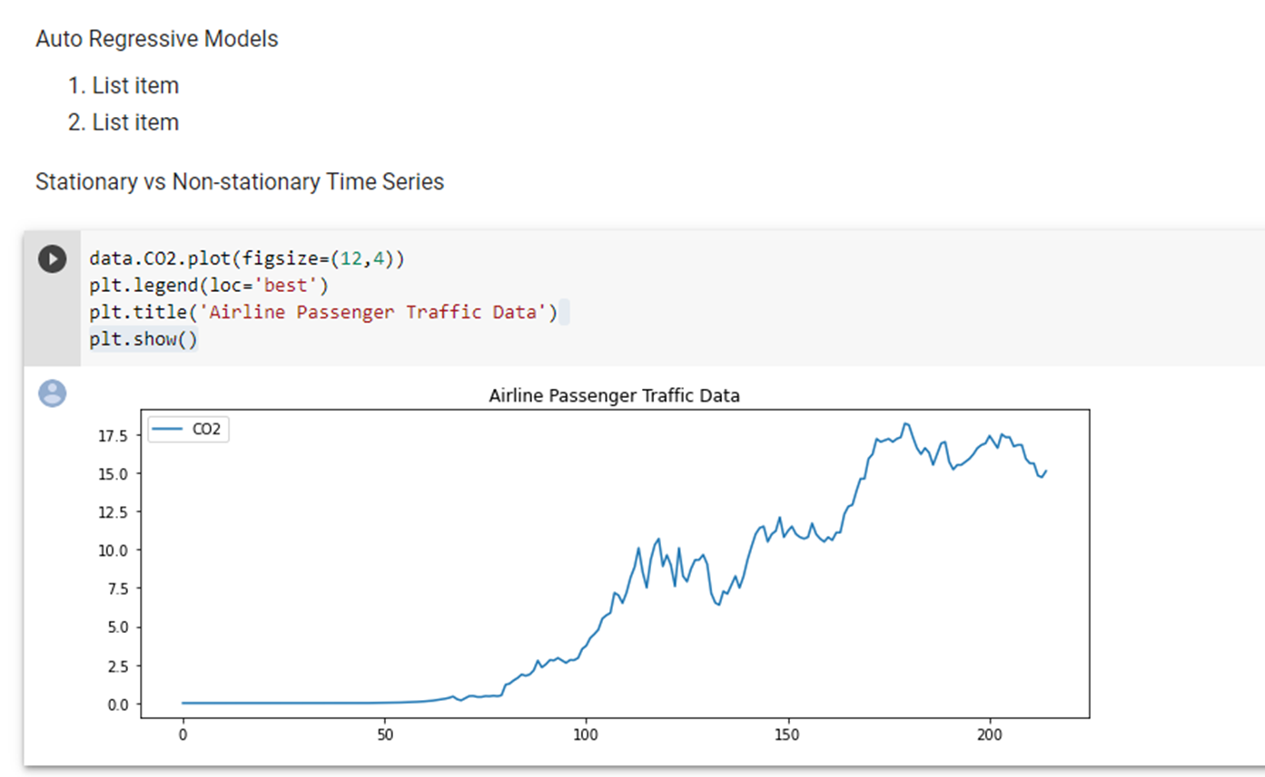

Slide 46
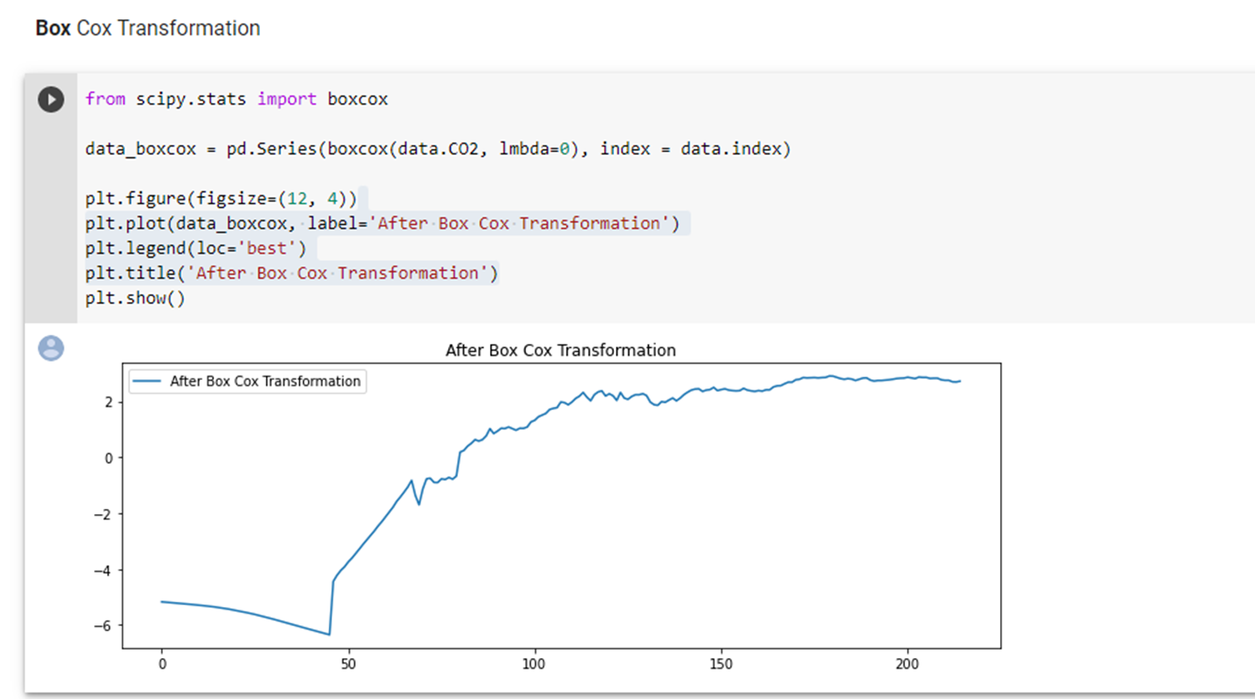
Box Cox Transformation

Slide 47
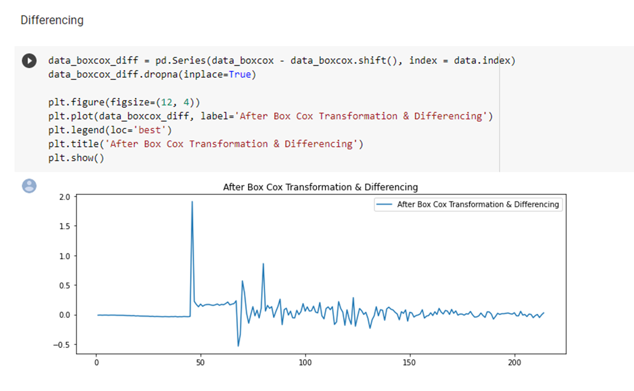

Slide 48
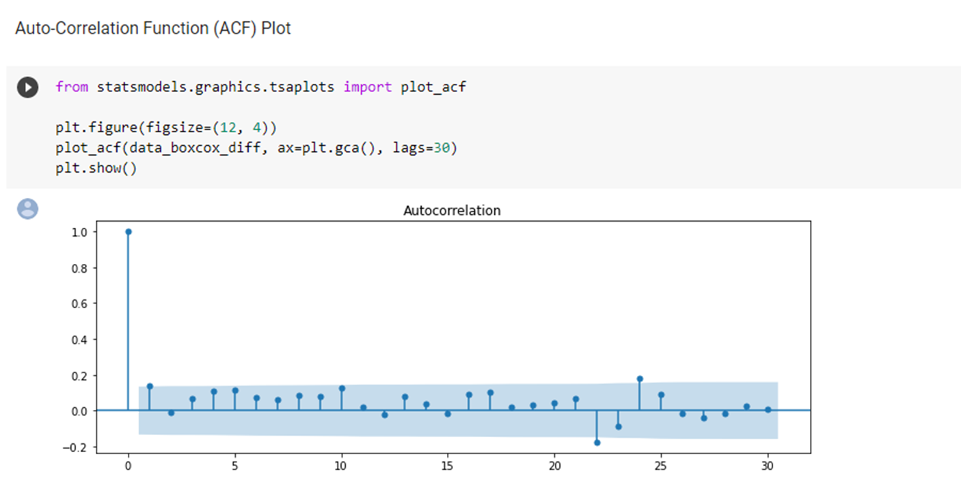

Slide 49
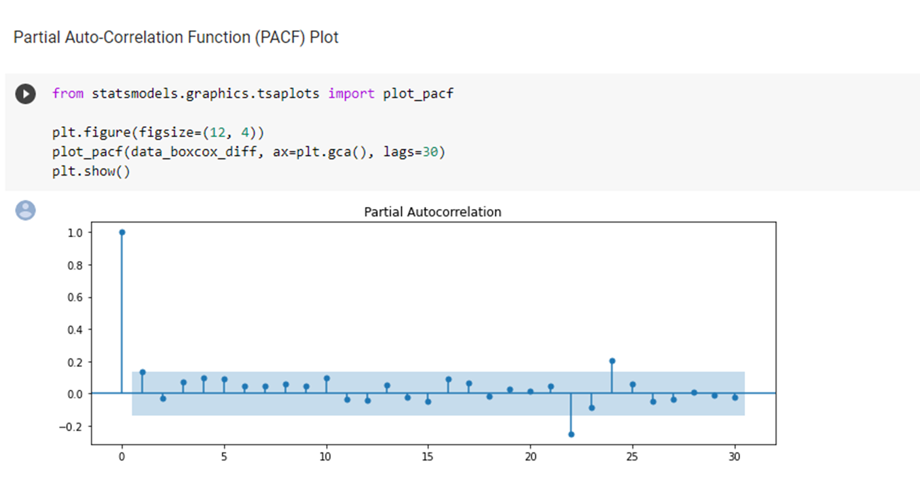

Slide 50
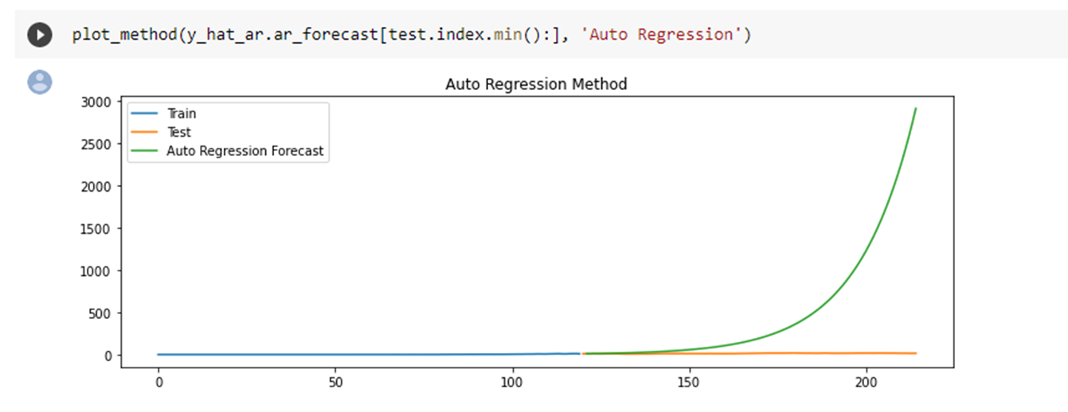

Slide 51
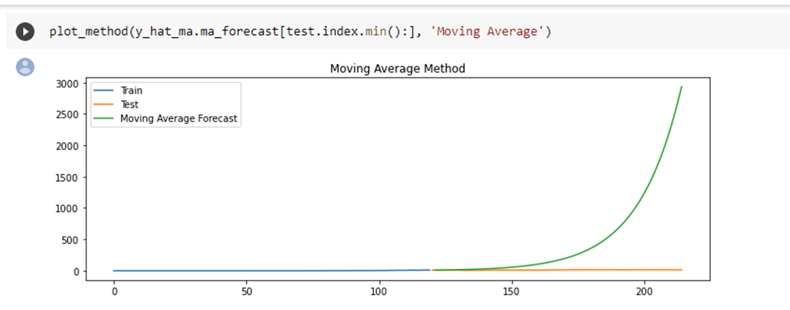

Slide 52
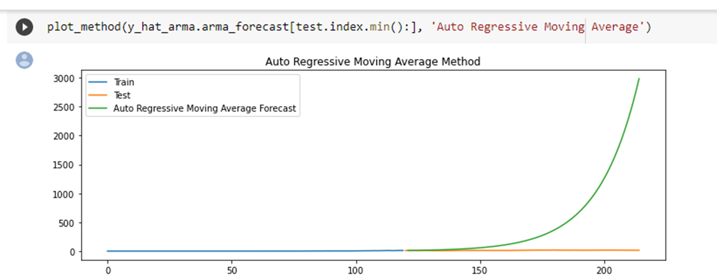

Slide 53
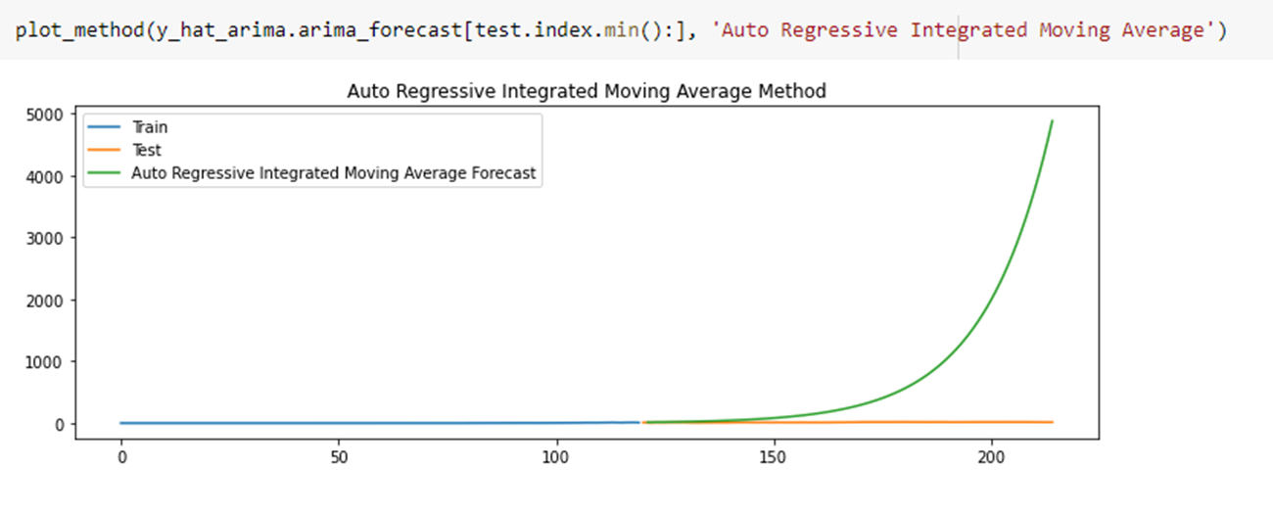

Slide 54
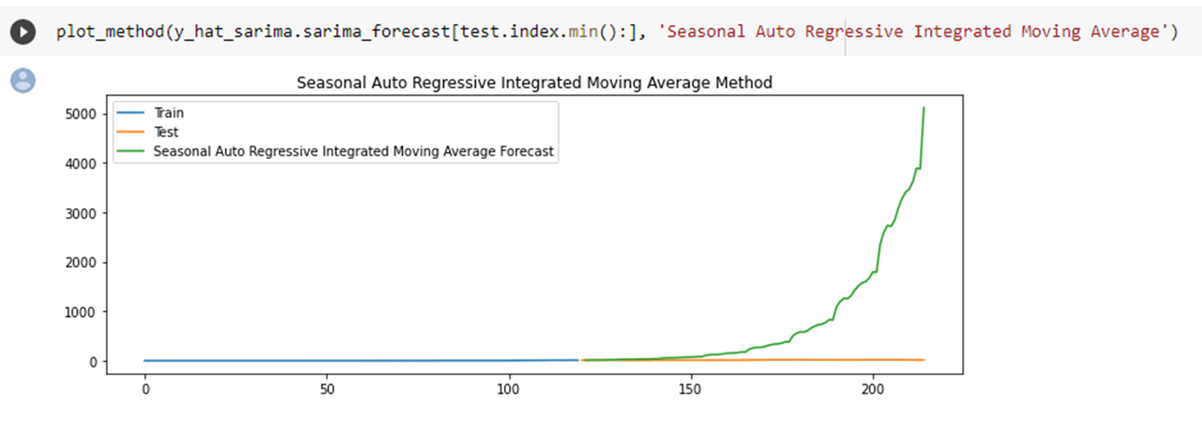

Slide 55
Final Output
Method | RMSE
Naive Method | 5.51
Simple Average Method | 12.02
Simple Moving Average Method | 5.76
Simple Exponential Smoothing Method | 5.50
Holt's Exponential Smoothing Method | 1.93
Holt's Winter Additive Method | 9.46
Autoregressive | 0.603
ARIMA | 0.424
As per the above table values we finalize the ARIMA is the best Model.

Slide 56
Thank you

